Slide 1
Ray Framework
ECE – 718 Om Tank

Slide 2
Recap:
Open-source and Distributed computing framework which is majorly built for the Python data science community.
Simplifies scaling compute-intensive Python workloads, making it easier to structure and run machine learning & deep learning programs at bigger scale.
Run and tested locally on a cluster practically without any changes.

Slide 3
Recap (2):
Ray Core APIs:
ray.init(): Initializes your Ray cluster.
@ray.remote: Turns functions into tasks and classes into actors.
ray.put(): Puts values into Ray’s object store.
ray.get(): Gets values from the object store. Returns the values you’ve put there or that were computed by a task or actor.
.remote(): Runs actor methods or tasks on your Ray cluster and is used to instantiate actors.
ray.wait(): Returns two lists of object references, one with finished tasks we’re waiting for and one with unfinished tasks.

Slide 4


Comparison between different frameworks:
Parameters | Ray | Dask | PyTorch
Support end-to-end workflows including training, tuning and deployment
Native actor-based programming for stateful computations (Hold data & communication between tasks)
Heterogenous CPUs/GPUs workload support
Fault Tolerance
Scalability & Dynamic Workload Management
In-built libraries for performing Machine learning operations

Slide 5
Ray Datasets:
Ray Data is a scalable data processing library for ML workloads, particularly suited for the data preprocessing and batch inference.
It is designed to handle large datasets efficiently across a distributed cluster, making it ideal for machine learning and preprocessing tasks.
Simplifies data preprocessing tasks such as filtering, grouping, and transformations with an intuitive API.
Automatically recovers from node failures and reschedules tasks across the cluster.
Supports multiple file formats like CSV, Parquet, JSON, and more.

Slide 6
Comparison Ray Dataset & Pandas:
Feature | Pandas | Ray
Scalability | Single node & limited by memory | Distributed and can handle large memory datasets.
Failure Recovery | No in-built failure recovery | Resilient to node failures
Ease of Use | User-friendly | User-friendly like Pandas
Performance | Excellent for small datasets | Optimized for complex workloads
Integration | Minimal integration with ML | Seamless integration with Ray Train and ML frameworks

Slide 7
Ray Train:
Ray Train is a distributed training library that simplifies scaling machine learning (ML) training workloads across multiple devices (CPUs, GPUs, or nodes in a cluster).
Ray Train have two main components:
Training Function (Trainers): Trainers are wrapper classes around third-party training frameworks like XGBoost, Pytorch, and TensorFlow providing integration with core Ray actors (for distribution), Ray Tune, and Ray Datasets.
Scaling Configuration: Mechanism for defining the scale of training job. Two parameters num_workers and use_gpu for workload resources.

Slide 8
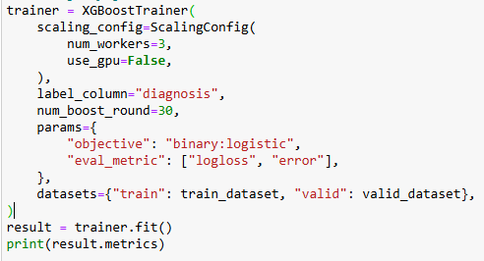
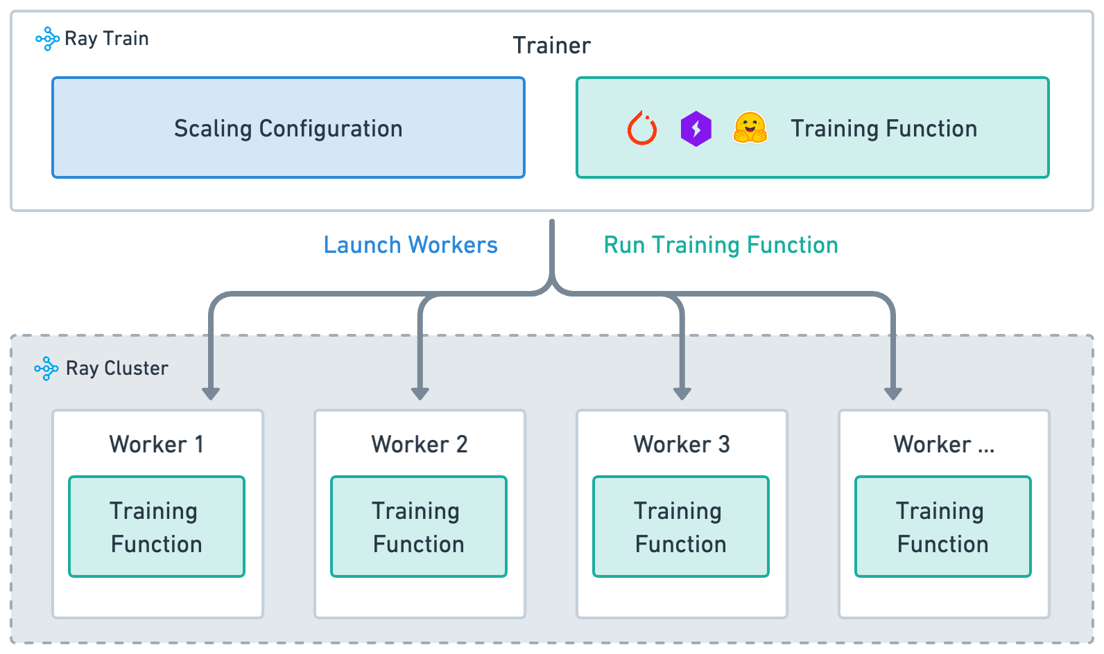
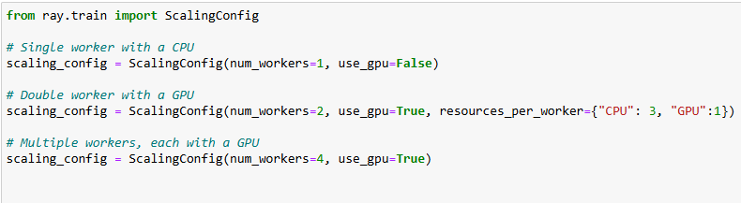
Ray Train: (2)

Slide 9
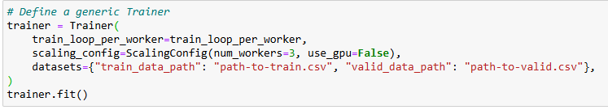
Ray Train: (3)
Define a generic Trainer().
Here, train_loop_per_worker is custom training model function which we have created.

Slide 10
Ray Tune:
Ray Tune is a tuning library for experiment execution and hyperparameter tuning at any scale.
It supports distributed hyperparameter optimization, making it ideal for large-scale machine learning workflows.
Ray Tune automates the process of finding the best set of hyperparameters for a model by managing the execution of multiple trials in parallel.
It works with any Python-based machine learning framework (e.g., PyTorch, TensorFlow, XGBoost, Scikit-learn).

Slide 11
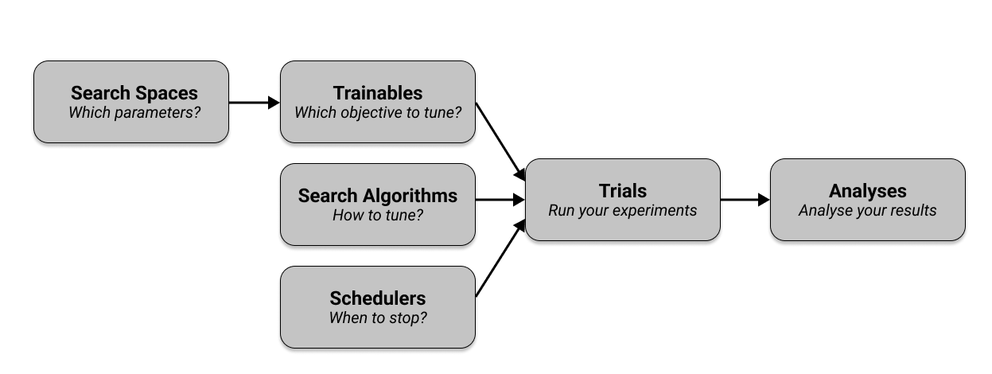
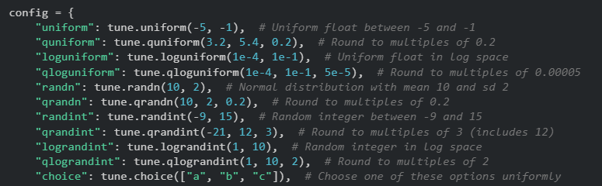
Components of Ray Tune:
Search Spaces:
Defines the valid values for hyperparameters and specify how these values are sampled.
Tune offers various functions and APIs to define search spaces and sampling methods

Slide 12
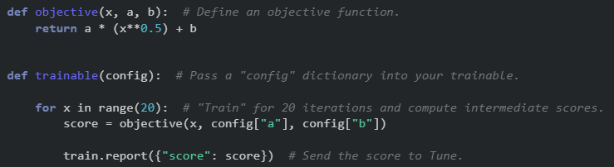
Components of Ray Tune:
2. Trainable:
Trainable is an objective function that you can pass into Tune run to optimize.
Here, config argument in the function is a dictionary populated automatically by Ray Tune and corresponds to hyperparameters selected for the trials from the search space.

Slide 13
Components of Ray Tune:
3. Search Algorithms:
Defines how hyperparameters are sampled for each trial. (Default: Random search algorithm)
Ray Tune supports Grid Search, Bayesian Optimization, Population-based Training (PBT)

Slide 14
Components of Ray Tune:
4. Schedulers (Optional):
Controls when to stop, pause, or prioritize trials based on their performance.
Example:
FIFOScheduler – First In First Out
ASHA (Asynchronous Successive Halving Algorithm) - Automatically stops poorly performing trials to save resources.
Median Stopping Rule – Stops trials if performance is worse than the median.

Slide 15
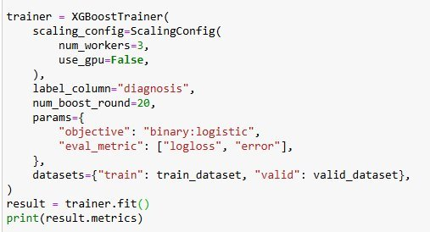
Components of Ray Tune:
5. Trials:
A single instance of training & testing with a unique set of hyperparameters
Executes trials in parallel using specified search algorithm and scheduler and evaluates its results, and reports metrics.
Tuner.fit() - use to execute, manage and generate the trials.
We can get hyperparameter configuration, trial ID and resource specification and even schedulers too.

Slide 16
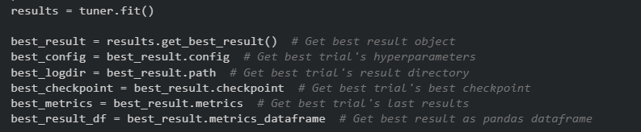
Components of Ray Tune:
6. Analysis:
Aggregates results from all trials to identify the best hyperparameter configuration.
Provides tools to analyze and visualize tuning outcomes.
Metrics such as the best hyperparameters and their performance are available for further evaluation.

Slide 17
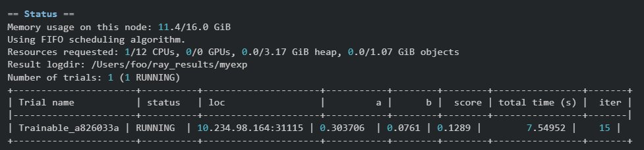
Ray Tune Dashboard:

Slide 18
Example-1: (XGBoost library)
XGBoost (Xtreme Gradient Boosting) is distributed gradient boosting library.
It implements machine learning algorithms under the Gradient Boosting framework.
Ray provides an interface to run XGBoost training and prediction jobs on Ray cluster.
It integrates well with hyperparameter optimization library Ray Tune and implements advanced fault tolerance handling mechanisms.
With Ray you can scale your training jobs to hundreds of nodes just by adding new nodes to a cluster.

Slide 19
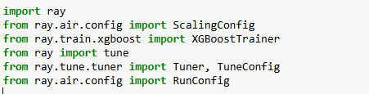

Implementation:
Import the libraries and install ray if not install earlier.
Reads a CSV file into a Ray Dataset for distributed processing.

Slide 20
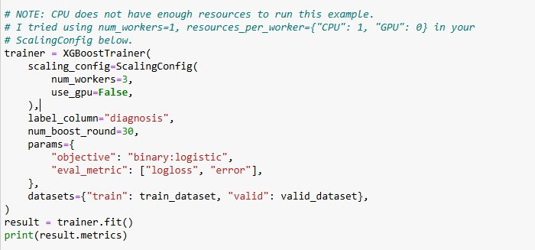
Implementation of Training model: (2)
Define the trainable object and manage distributed training of XGBoost model.
ScalingConfig configures the resource allocation of CPUs/GPUs for training.

Slide 21
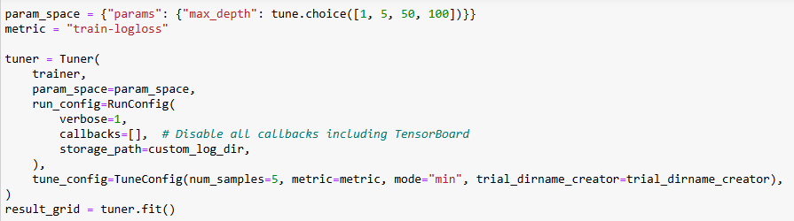
Implementation: (3)
Defines the hyperparameter search space (max_depth: Maximum depth of decision trees)
Initialize tuner with XGBoost model (trainer), search space (param_space) and number of trials (num_samples) and optimization criteria (minimum training logloss).

Slide 22
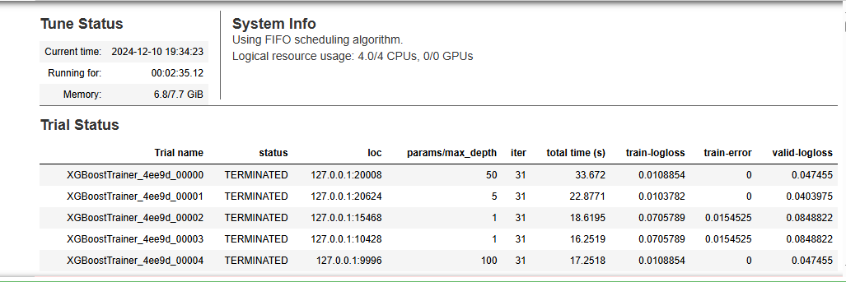
Results:

Slide 23
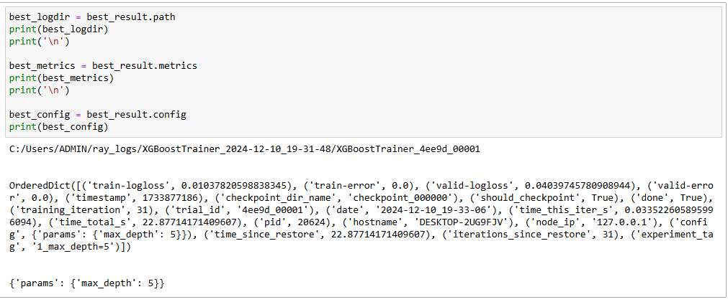
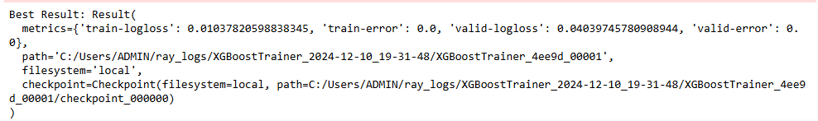
Results: (2)

Slide 24
Results: (3)
Execution Time with Ray: | Execution Time without Ray:
Approx. 2.5 minutes with hyperparameters tuning | Approx. 2 minutes without Tuning

Slide 25
Example-2: (CNN using TensorFlow)
A Convolutional Neural Network (CNN) is a Deep Learning algorithm that can take in an input image, assign importance (learnable weights and biases) to various aspects/objects in the image, and be able to differentiate one from the other
It extracts patterns from images (like edges, textures) using convolutional layers.
Used CIFAR-10 which is a standard dataset in computer vision containing 60,000 color images of 32x32 pixels, divided into 10 classes (e.g., airplane, bird, truck).
Implemented Ray Tune for hyperparameter tuning and optimize using Population-Based Training (PBT).

Slide 26
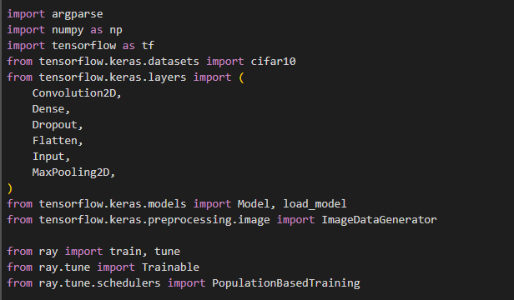
Implementation:
Import the libraries and install ray if not install earlier.

Slide 27
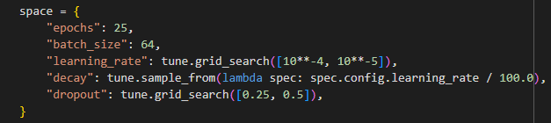
Implementation: (2)
Define the search space for tuning the hyperparameter.

Slide 28
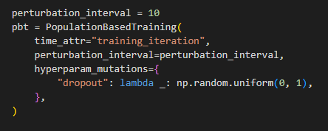
Implementation: (3)
Population-Based Training (PBT): Optimizes hyperparameters through a trial population and continuously refines them over time.
PBT starts with a population of trials, each with a unique set of initial hyperparameters sampled from a pre-defined search space.
At regular intervals (perturbation_interval), PBT identify poorly performing trials based on their performance metrics (e.g., accuracy) and replace their model weights and hyperparameters with those of better-performing trials in the population.
PBT repeats cycle as following: Train --> Evaluate --> Exploit --> Explore

Slide 29
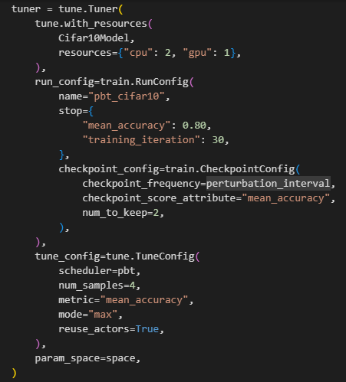
Implementation: (4)
tune.with_resources: Defines the 2 CPUs & 1 GPUs resources for Cifar10Model during training.
Here, we have defined the custom model to execute in the trial (Cifar10Model).
RunConfig(): Configures the runtime environment for tuning job like stopping criteria like accuracy and training iterations (how many times we can update the hyperparameters).

Slide 30
Implementation: (5)
CheckpointConfig used to save the state of model after every 20 iterations and specify the metrics to compare checkpoints.
num_to_keep limits the number of most recent checkpoints retained for trial.
TuneConfig(): Defines how Ray manages and optimizes the tuning trials like number of trials, optimization criteria (mean accuracy, mode) and reuses resources across trials.

Slide 31
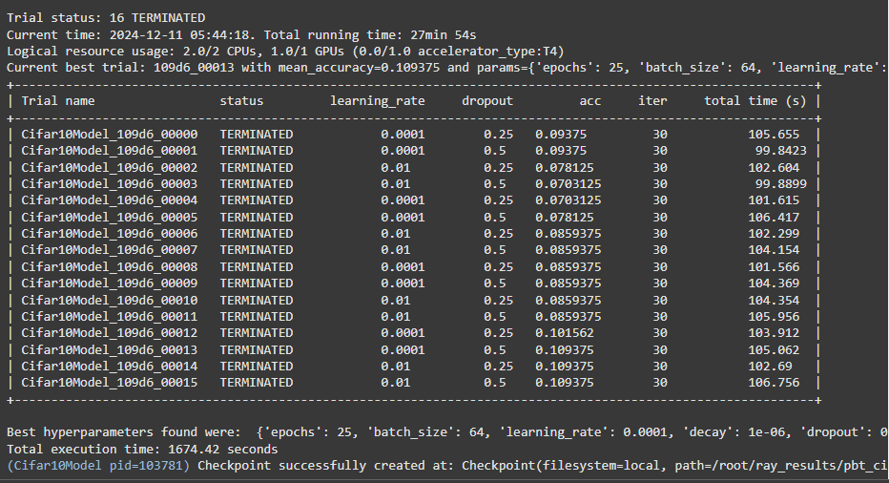
Results: (1)

Slide 32
Results: (2)
Execution Time with Ray: | Execution Time without Ray:
Approx. 27 minutes with hyperparameters tuning for 400 epochs | Approx. 40 minutes for 25 epochs

Slide 33
Thank You

